Slide 1
Dry Bean classification
Prepared by :
Abinash Sonowal 210101004
Anoop singh 210101016
Kundan meena 210101060
Ravi laharae 210101086

Slide 2
Overview of the Problem
Dry beans are an essential staple food consumed worldwide, providing a significant source of protein, fiber, vitamins, and minerals. However, the diversity of dry bean varieties poses a challenge in terms of classification, leading to confusion among consumers, producers, and other stakeholders. Without a standardized classification system, there is ambiguity regarding the characteristics, uses, and market value of different types of dry beans.

Slide 3
Objective
Develop a comprehensive classification system for dry beans.
Categorize beans based on size, shape, color, texture, culinary uses, and nutrition.
Provide clarity and guidance to stakeholders in production, distribution, and consumption.

Slide 4
Data Collection and Preprocessing:
Source of Data: The dataset was collected from "kaggle."
Preliminary Analysis: To gain initial insights, a comprehensive Pandas profiling analysis was conducted on the dataset. This analysis provided a detailed overview and statistical summary of the dataset's characteristics.
Dataset Details:
1. Rows and Columns: The dataset contains 13,611 rows and 17 columns.68 duplicate rows and 0 null attributes
2. Attributes: The dataset includes 12-dimensional and 4 shape feature attributes.
3. Feature Scaling: Standardizing features ensures they have a mean of 0 and a standard deviation of 1.

Slide 5
Data Collection and Preprocessing:
4. Outlier Removal: Identifying and removing outliers ensures data integrity and reliability.
5. Label Encoding: Convert categorical target variable to numerical labels using LabelEncoder to enable correlation analysis.
6. Correlation Analysis: After encoding the target variable, the correlation between each feature and the "Class" variable is computed.

Slide 6
Exploratory Data Analysis (EDA):
Univariate Distributions for all features, conditional on target.
Observation :
Bombayclass exhibited distinct characteristics markedly different from the other classes, particularly in terms of grain size,which appeared substantially larger
All instances falling under the Bombay class were identified as outliers.
The Bombay class was excluded from further consideration in subsequent analyses.
Figure :

Slide 7
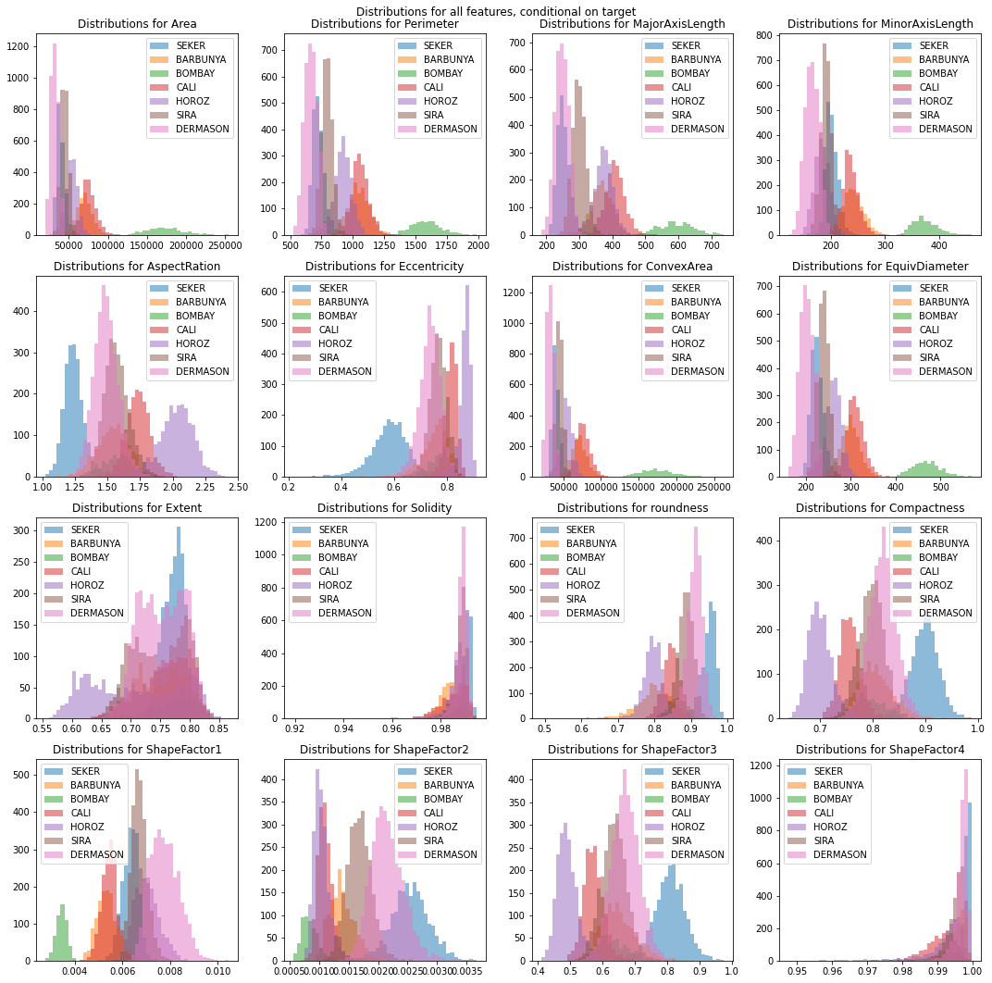

Slide 8
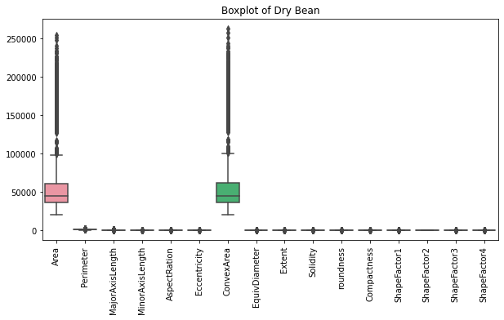
Exploratory Data Analysis (EDA):
Box plot

Slide 9
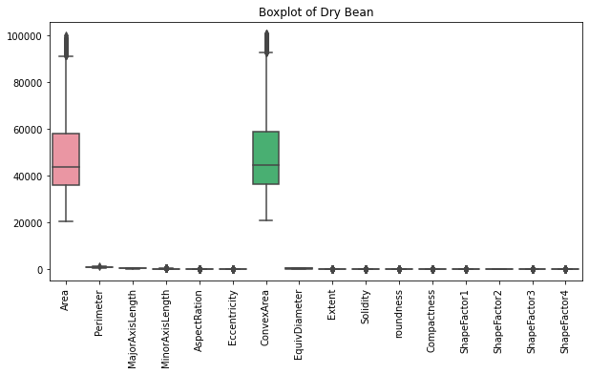
Exploratory Data Analysis (EDA):
Box plot after removal of outliers

Slide 10
Exploratory Data Analysis (EDA):
Joint scatter plots of two features
Observation : A key observation was the emergence of two-dimensional regions wherein representatives of almost exclusively one class were contained. Additionally, it was noted that many scatterplots exhibited a certain degree of ”isomorphism” -clusters for different classes displayed similar relative locations, potentially up to symmetry. For instance, the Sira class was positioned between other classes, suggesting a distinct pattern in the dataset.
Figure :

Slide 11
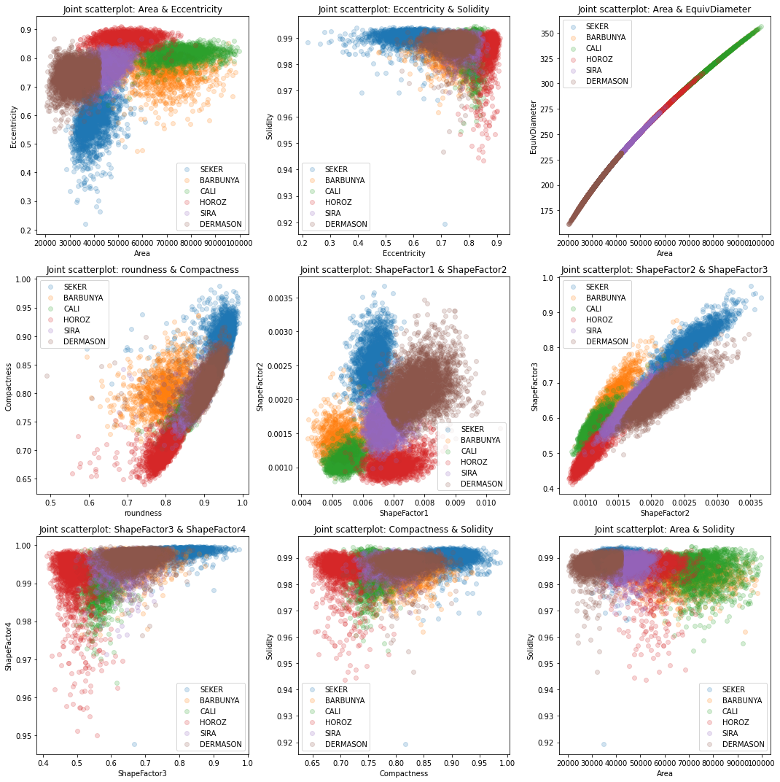

Slide 12
Model Checking and Predictions :
1. Logistic Regression
2. Decision Tree
3. Support Vector Machine(SVM)

Slide 13
Logistic Regression :
Inbuild
Custom
Normal Score : 0.9946308724832215
Mean Absolute Error : 0.013422818791946308
Precision: 0.9306760571494411
Recall: 0.8793220338983051
F1 Score: 0.9020866805739601
Accuracy : 0.5906040268456376
Precision: 0.2377213618716354
Recall: 0.3203844405480875
F1 Score: 0.27289090995215765

Slide 14
Logistic Regression :
Custom Logistic Regression Implementation:
• Advantage: Provides a custom implementation of logistic regression, offering insights into the inner workings of the algorithm and allowing for customization.
• Disadvantage: Lower accuracy and precision compared to the scikit-learn implementation, indicating potential limitations in optimization or hyperparameter tuning.

Slide 15
SVM Model
Inbuild
Custom
SVM Classifier Score: 0.9946308724832215
Mean Absolute Error: 0.01476510067114094
Precision: 0.996590909090909
Recall: 0.8300000000000001
F1 Score: 0.8677610264978686
Accuracy: 0.3959731543624161
Precision: 0.6145833333333334
Recall: 1.0
F1 Score: 0.7612903225806451

Slide 16
SVM Model
Custom SVM Model:
• Implements a custom SVM classifier with a gradient descent optimization algorithm.
• Achieves lower accuracy and precision compared to the SVM model from scikit- learn.
• Performance may be impacted by the simplicity of the optimization algorithm and hyperparameter settings.

Slide 17
Decision Tree
Inbuild
custom
Normal Score : 1.0
Mean Absolute Error : 0.0
Mean Squared Error: 0.0
R-squared: 1.0
Accuracy: 0.7442799461641992
Precision: 1.0
Recall: 1.0
F1 Score: 1.0
rmse: 0.25
mae: 0.05
r2: 0.92

Slide 18
Decision Tree
Custom Decision Tree :
• Advantage: Provides a custom implementation of a decision tree regressor, offering insights into the inner workings of the algorithm and allowing for customization.
Achieves good accuracy and high precision and recall, indicating strong predictive performance

Slide 19
Conclusion
Model Performance Variation:
While logistic regression, decision tree, and SVM models implemented with scikit-learn achieved high accuracy and robust classification, custom implementations exhibited lower performance.
Effectiveness of scikit-learn Implementations:
Models trained using scikit-learn's implementations demonstrated superior performance with near-perfect accuracy and optimal metric scores.This suggests that scikit-learn's algorithms effectively capture the underlying patterns in the data and produce highly accurate classification results.
Custom Model Limitations:
Custom implementations of logistic regression, SVM, and decision tree models showed lower accuracy and less precise classification compared to scikit-learn's implementations. These custom models may require further optimization or tuning to match the performance of scikit-learn's algorithms.
Considerations for Model Selection:
When selecting models for classification tasks with KMeans processed data, it's advisable to prioritize scikit-learn's implementations of logistic regression, decision trees, and SVM for their superior performance.However, custom implementations may still be viable options depending on specific project requirements and the need for customization.

